Slide 1


4.1 Introduction to javascript
Computers don’t understand JavaScript — browsers do.
Lavanya Seetharaman
Instructor@BoardInfinity

Slide 2

Story of web
Web born on 1989
Tim Berners-Lee, a British scientist
Initial purpose - automated information-sharing between scientists in universities and institutes around the world.
November 1990 - outlined the principal concepts and it defined important terms behind the Web
The document described a "hypertext project" called "WorldWideWeb" in which a "web" of "hypertext documents" could be viewed by “browsers”.
World's first website and Web server - info.cern.ch
First web page address - http://info.cern.ch/hypertext/WWW/TheProject.html
Source : https://home.cern/science/computing/birth-web/short-history-web

Slide 3
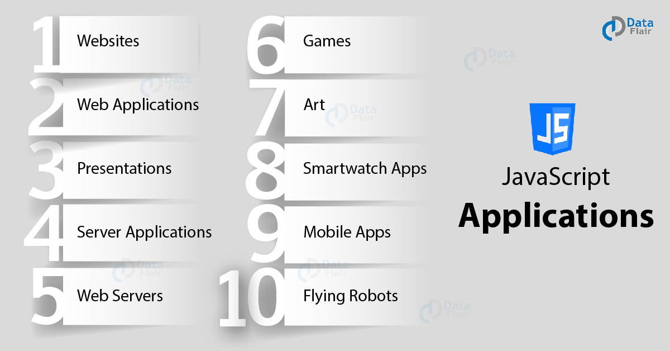
JavaScript
It is one of the popular programming language of the Web.
It is easy to learn and can be integrated with HTML.
Since it is lightweight, interpreted programming language, it is highly recommended by all the developers.
It is open and cross-platform language, used widely.
Few applications of it are listed here -
Source : https://data-flair.training/blogs/javascript-uses/

Slide 4
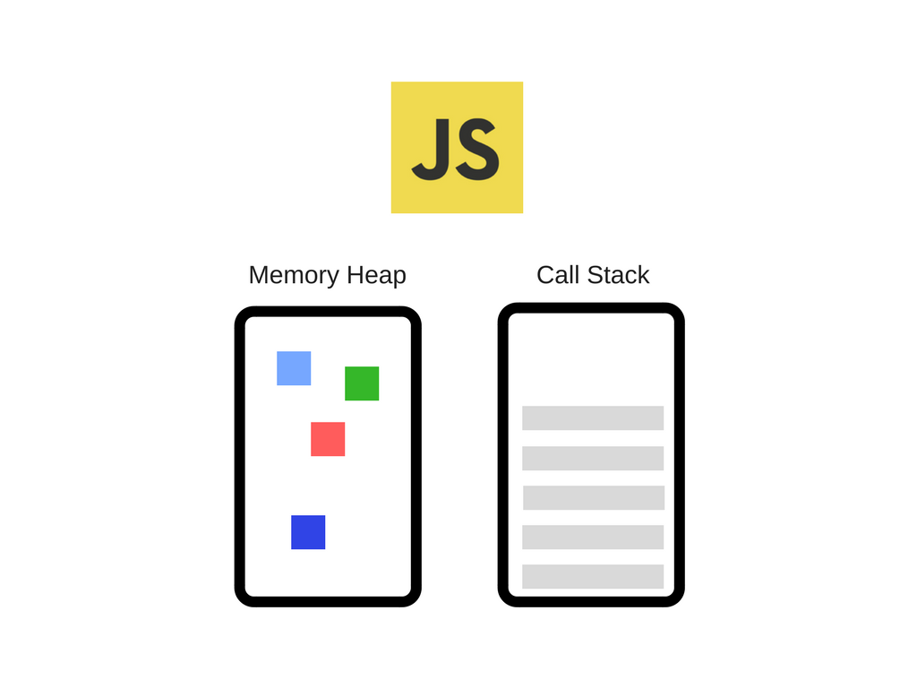
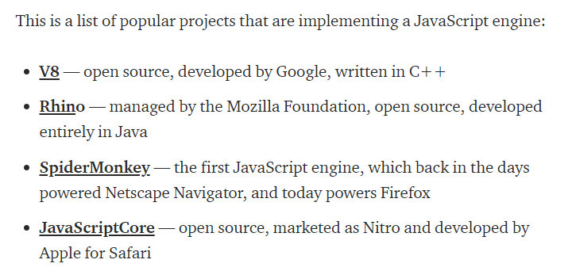
Javascript Engine
The Engine consists of two main components:
* Memory Heap — this is where the memory allocation happens
* Call Stack — this is where your stack frames are as your code executes.

Slide 5
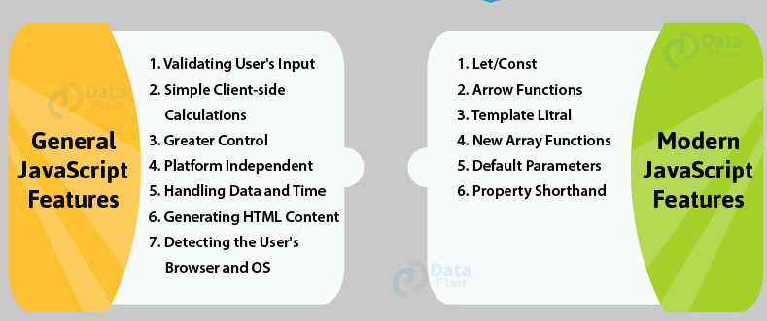
Features

Slide 6
4.2 javascript- Datatypes & Variables
Computers don’t understand JavaScript — browsers do.
Lavanya Seetharaman
Instructor@BoardInfinity

Slide 7
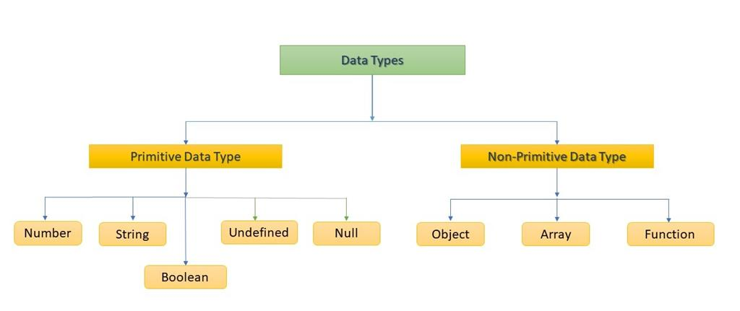
Data Types
.

Slide 8
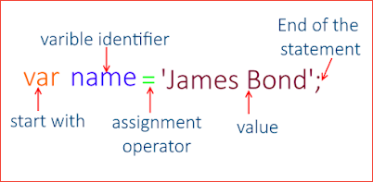
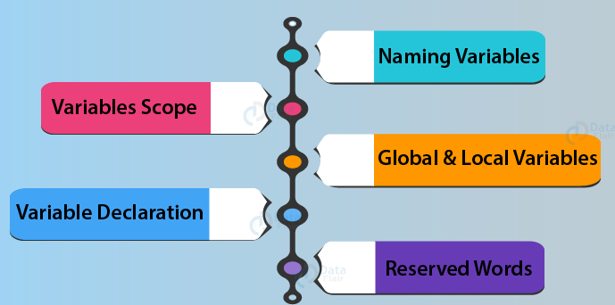
Variables
It acts as container for storing data values.

Slide 9
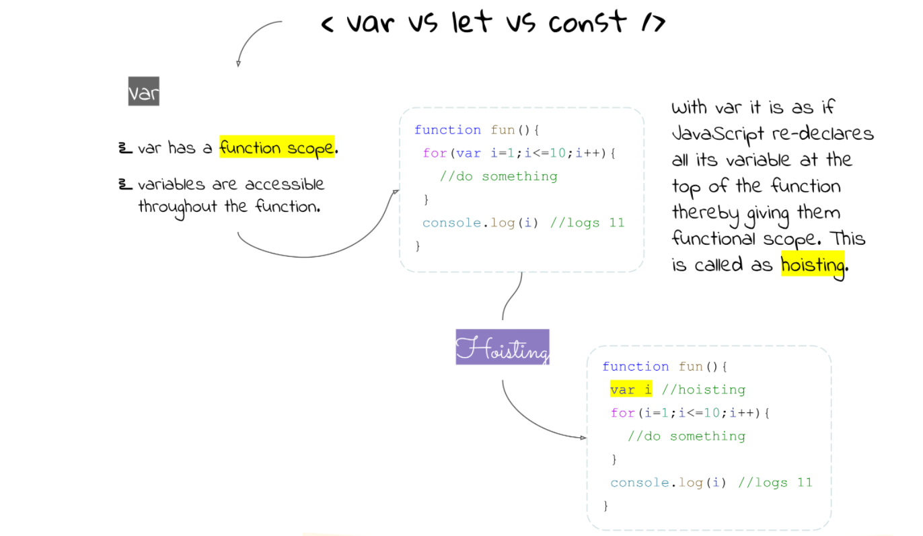
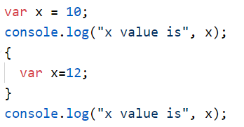
Variables/Let/Const
Source:https://medium.com/swlh/var-let-and-const-4b3e5f98b1d9

Slide 10
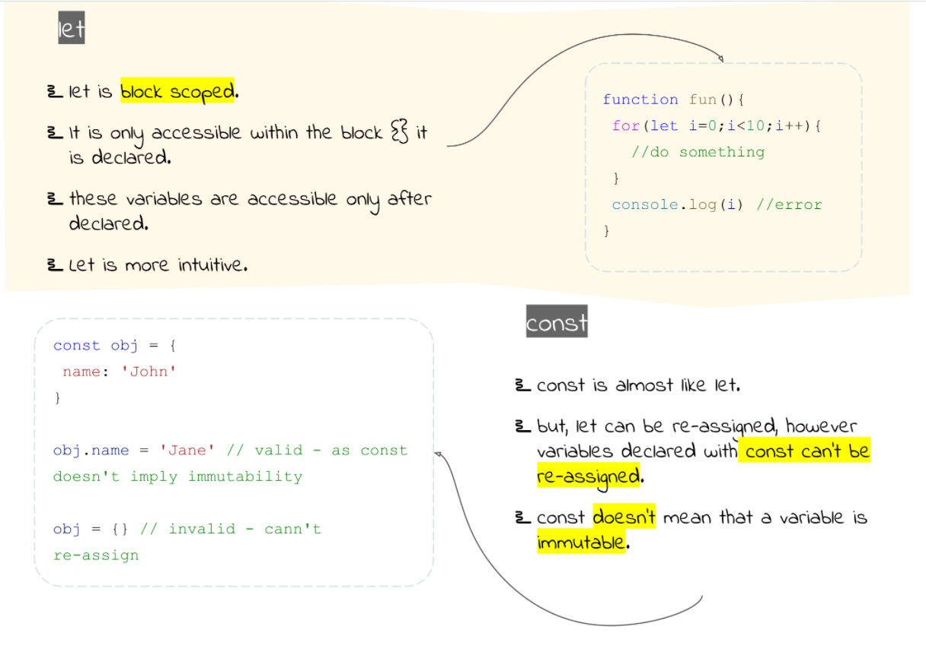
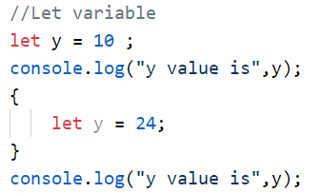
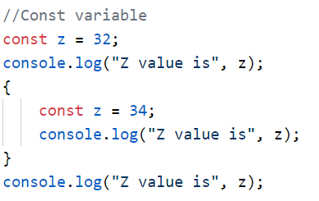
Variables/Let/Const

Slide 11
JAVASCRIPT NAMING CONVENTIONS:
VARIABLES
var name = 'Robin ';
var Name = 'Dennis ';
var NAME = 'Thomas ';
console.log(name);
// "Robin"
console.log(Name);
// "Dennis"
console.log(NAME);
// "Thomas"
// bad
var firstname = 'Robin';
// bad
var first_name = 'Robin';
// bad
var FIRSTNAME = 'Robin';
// bad
var FIRST_NAME = 'Robin';
// good
var firstName = 'Robin';
// bad
var encryption = true;
// good
var hasEncryption = true;
JavaScript variables are case sensitive.
Functions
Class
Source:https://www.robinwieruch.de/javascript-naming-conventions

Slide 12
4.3 javascript- Operators
Computers don’t understand JavaScript — browsers do.
Lavanya Seetharaman
Instructor@BoardInfinity

Slide 13
Operator
an operator is a special symbol used to perform operations on operands (values and variables)
2 + 3; // 5
JavaScript Operator Types
Assignment Operators
Arithmetic Operators
Comparison Operators
Logical Operators
Bitwise Operators
String Operators
Other Operators
Source: https://www.programiz.com/javascript/operators

Slide 14
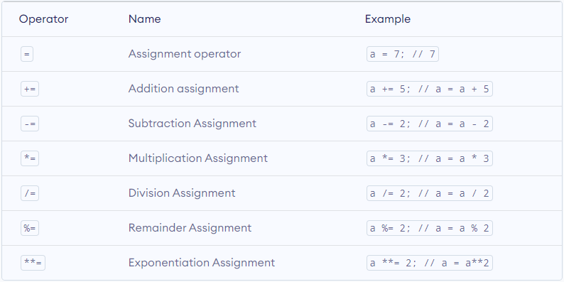
Assignment Operators

Slide 15
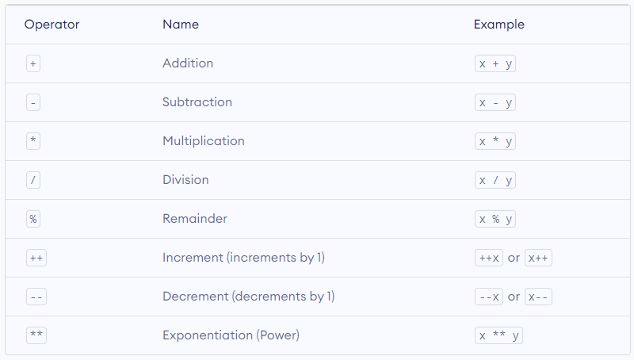
Arithmetic Operators

Slide 16
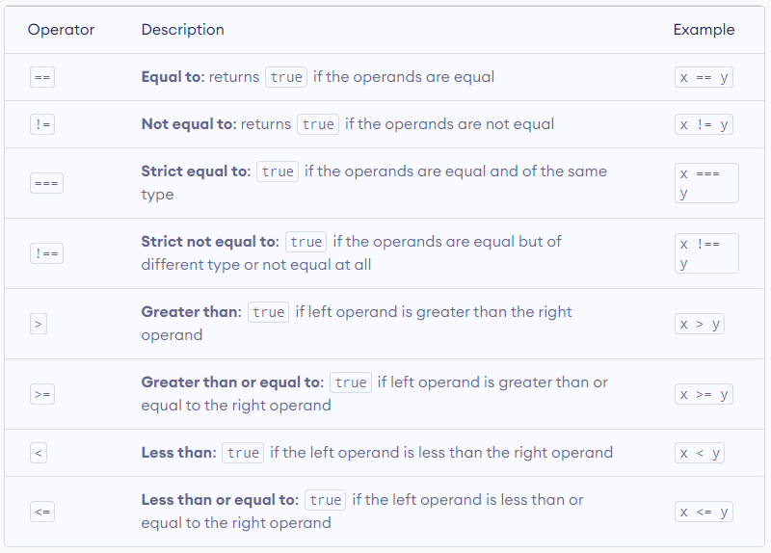
Comparison Operators

Slide 17
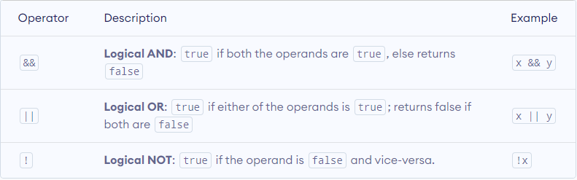
Logical Operators

Slide 18

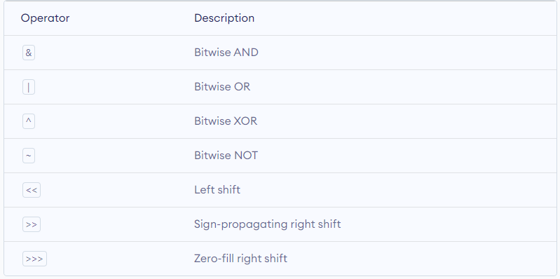
Bitwise Operators
https://www.programiz.com/javascript/bitwise-operators

Slide 19
4.4 javascript- Conditions
Computers don’t understand JavaScript — browsers do.
Lavanya Seetharaman
Instructor@BoardInfinity

Slide 20
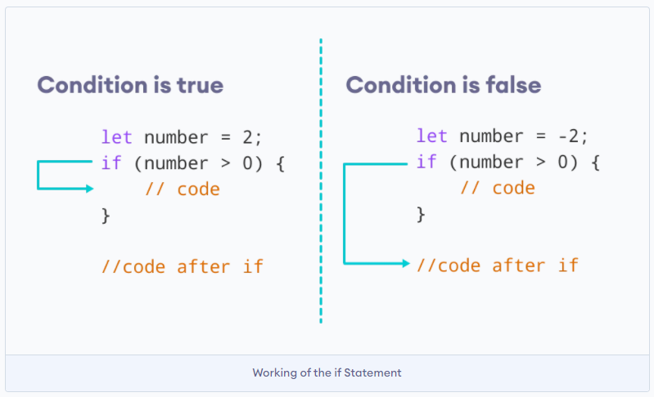
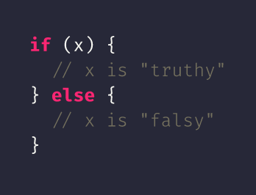
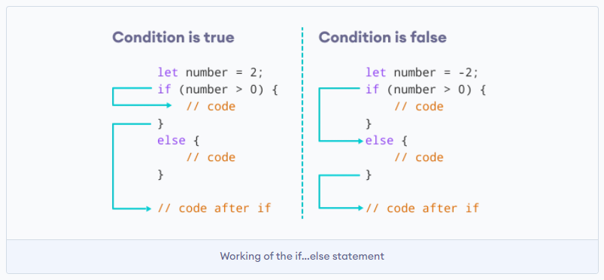
Conditions
Image source: https://www.programiz.com/javascript/if-else

Slide 21
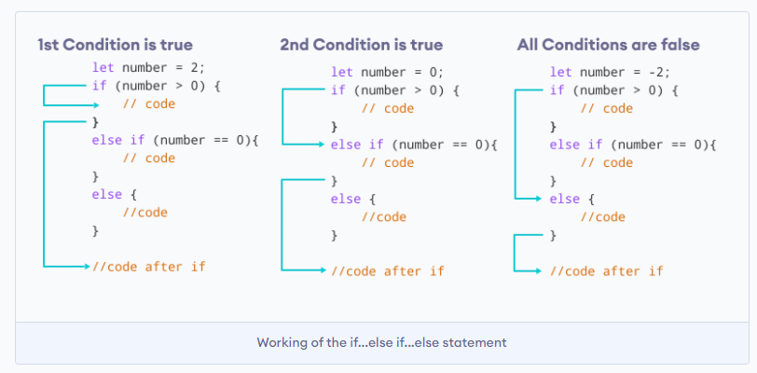
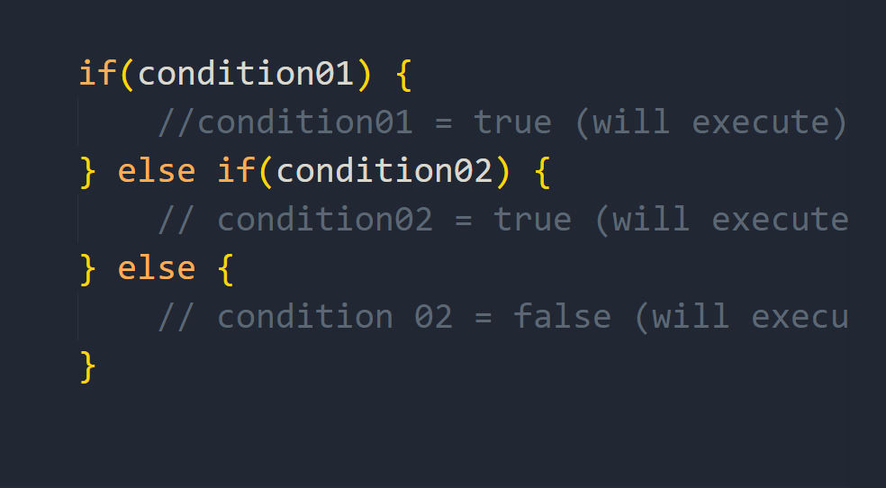
Conditions
Image source: https://www.programiz.com/javascript/if-else

Slide 22
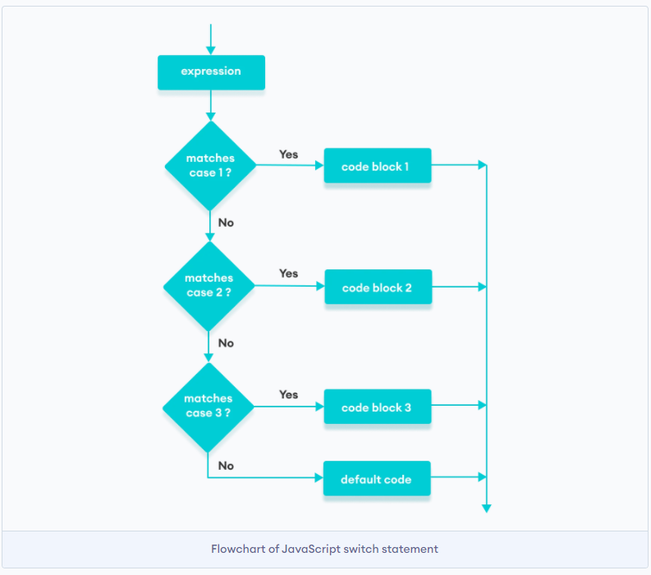
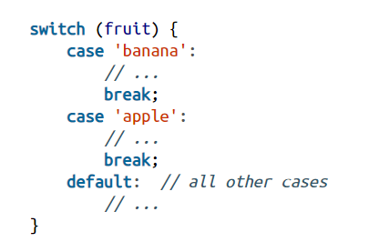
Switch Case

Slide 23
4.5 javascript- Loops
Computers don’t understand JavaScript — browsers do.
Lavanya Seetharaman
Instructor@BoardInfinity

Slide 24
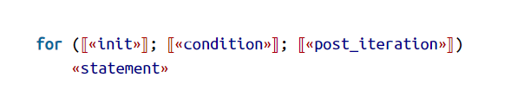
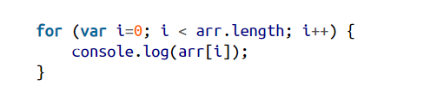
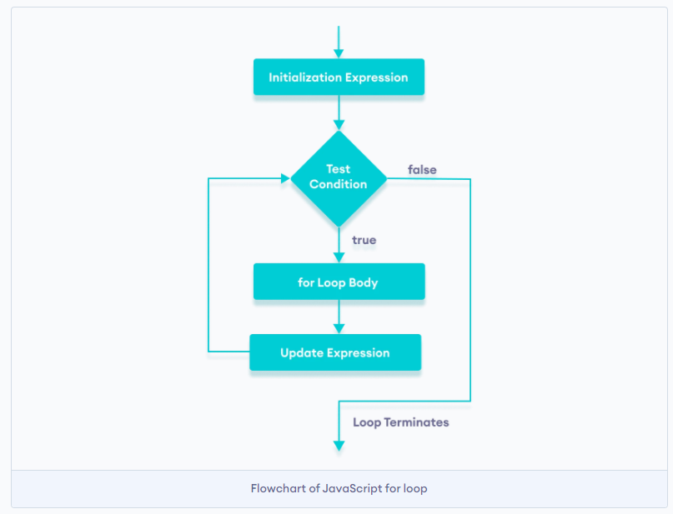
Loops
Syntax
Example: Prints all elements of the array on the console:
// program to display text 10 times
const n = 5;
// looping from i = 1 to 5
for (let i = 1; i <= n; i++) {
console.log(`I am learning Javascript`);
}

Slide 25
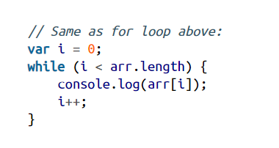
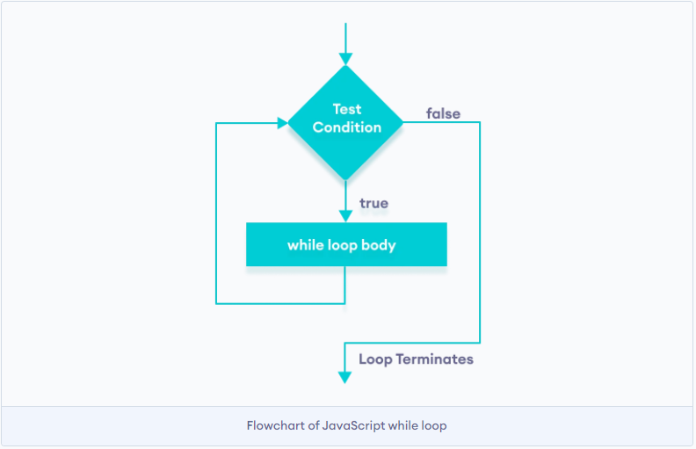
Loops
// program to display numbers from 1 to 5
// initialize the variable
let i = 1, n = 5;
// while loop from i = 1 to 5
while (i <= n) {
console.log(i);
i += 1;
}

Slide 26
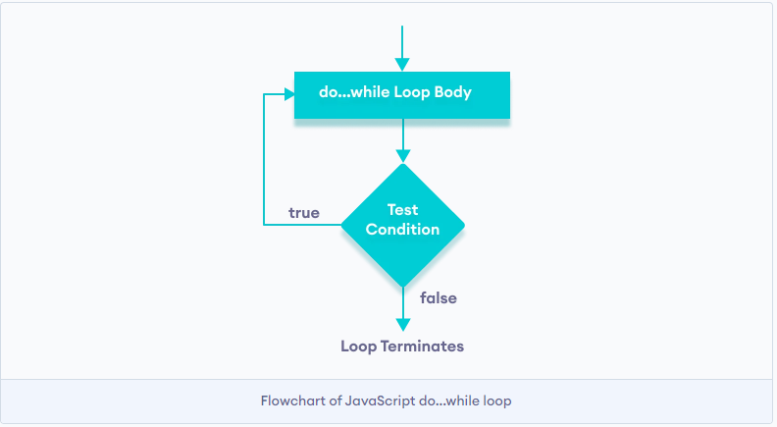
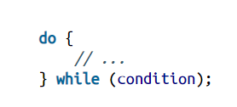
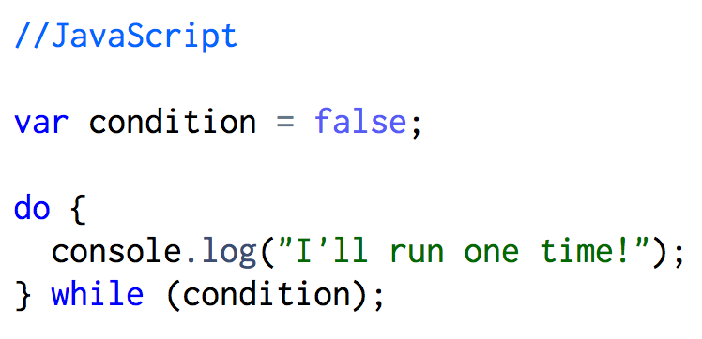
Loops

Slide 27
Conditions + Loops
PROBLEM #01
You are provided with a number, "N". Find its factorial.
Input Description:
A positive integer is provided as an input.
Output Description:
Print the factorial of the integer.
Factorial, in mathematics, the product of all positive integers less than or equal to a given positive integer and denoted by that integer and an exclamation point. Thus, factorial seven is written 7!, meaning 1 × 2 × 3 × 4 × 5 × 6 × 7. Factorial zero is defined as equal to 1.
Definition source: https://www.britannica.com/science/factorial

Slide 28
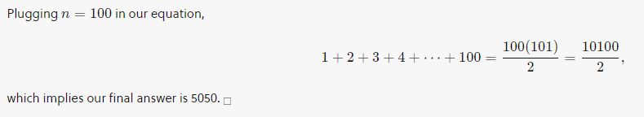
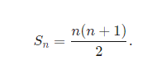
Conditions + Loops
PROBLEM #02
Write a js code to get an integer N and print the sum of values from 1 to N.
Input Description:
A single line contains an integer N.
Output Description:
Print the sum of values from 1 to N.
Definition source: https://brilliant.org/wiki/sum-of-n-n2-or-n3/

Slide 29


Your Turn
PROBLEM #03
You are provided with a number "N", Find the Nth term of the series: 1 , 4, 9, 16, 25,
36, 49, 64, 81, .......
(Print "Error" if N = negative value and 0 if N = 0).
Input Description:
An integer N is provided to you as the input.
Output Description:
Find the Nth term in the provided series.

Slide 30
4.6 javascript- Strings
Computers don’t understand JavaScript — browsers do.
Lavanya Seetharaman
Instructor@BoardInfinity

Slide 31
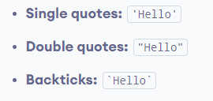
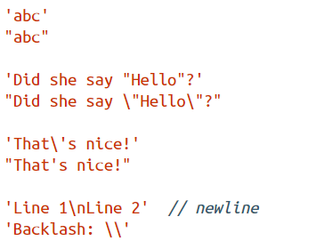
Strings
Strings can be created directly via string literals.
Those literals are delimited by single or double quotes.
The backslash (\) escapes characters and produces a few control characters.
Here are some examples:
const a = 'hello';
const b = new String('hello');
//strings example
const name = 'Peter';
const name1 = "Jack";
const result = `The names are ${name} and ${name1}`;

Slide 32
Strings
JavaScript Strings are immutable
For Example
let a = 'hello';
a[0] = 'H';
console.log(a); // "hello"
let a = 'hello';
a = 'HELLO';
console.log(a); // "HELLO"

Slide 33
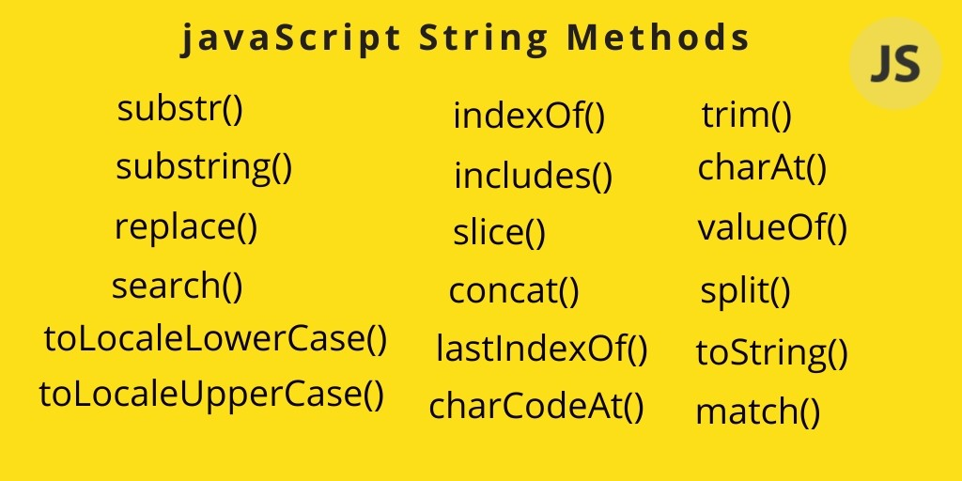
Built-in String Methods

Slide 34
Your Turn
PROBLEM #04
Let "A" be a string. Remove all the whitespaces and find it's length.
(Print “No whitespace available” .if user string has no whitespace)
Input Description:
A string is provide as an input
Output Description:
Remove all the whitespaces and then print the length of the remaining string.

Slide 35
4.7 javascript- Objects
Computers don’t understand JavaScript — browsers do.
Lavanya Seetharaman
Instructor@BoardInfinity

Slide 36
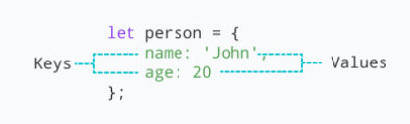
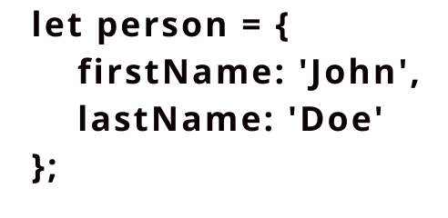
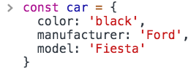
Objects
JavaScript object is a non-primitive data-type that allows you to store multiple collections of data.
const object_name = {
key1: value1,
key2: value2
}
Using dot Notation
objectName.key
Using bracket Notation
objectName["propertyName"]

Slide 37
Object Destructuring
It easy to assign array values and object properties to distinct variables
// assigning object attributes to variables
const person = {
name: 'Sara',
age: 25,
gender: 'female'
}
let name = person.name;
let age = person.age;
let gender = person.gender;
console.log(name); // Sara
console.log(age); // 25
console.log(gender); // female
// assigning object attributes to variables
const person = {
name: 'Sara',
age: 25,
gender: 'female'
}
// destructuring assignment
let { name, age, gender } = person;
console.log(name); // Sara
console.log(age); // 25
console.log(gender); // female

Slide 38
Object Destructuring
It easy to assign array values and object properties to distinct variables
// assigning object attributes to variables
const person = {
name: 'Sara',
age: 25,
gender: 'female'
}
// destructuring assignment
let { name, age, gender } = person;
console.log(name); // Sara
console.log(age); // 25
console.log(gender); // female
// destructuring assignment
// using different variable names
let { name: name1, age: age1, gender:gender1 } = person;
console.log(name1); // Sara
console.log(age1); // 25
console.log(gender1); // female

Slide 39
Object - Static methods
assign() create()
freeze()
entries()
fromEntries() isFrozen() keys() values() isExtensible() defineProperty() defineProperties()

Slide 40
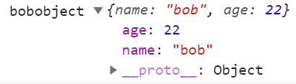
Prototypes→ inheritance
All objects in JavaScript inherit from at least one other object.
The object being inherited from is known as the prototype, and the inherited properties can be found in the prototype object of the constructor.
let bob = {
name:"bob",
age:22
}

Slide 41
4.8 javascript- Arrays
Computers don’t understand JavaScript — browsers do.
Lavanya Seetharaman
Instructor@BoardInfinity

Slide 42
Arrays
It lets us store multiple values in a single variable.
But, mainly of the same type.
For example
var students = ["S1", “S2", “S3"];
var students = new Array("S1", “S2", “S3");
// empty array
const myList = [ ];
// array of numbers
const numberArray = [ 2, 4, 6, 8];
// array of strings
const stringArray = [ 'eat', 'work', 'sleep'];
// array with mixed data types
const newData = ['work', 'exercise', 1, true];

Slide 43
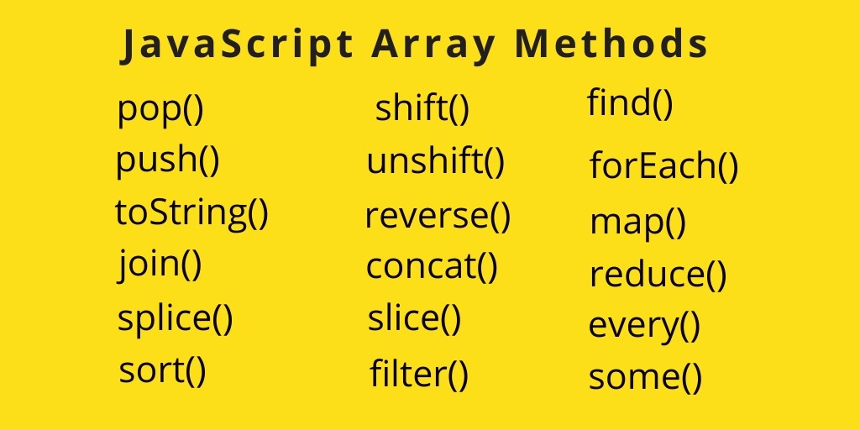
Array Methods

Slide 44
4.9 javascript - Functions
Computers don’t understand JavaScript — browsers do.
Lavanya Seetharaman
Instructor@BoardInfinity

Slide 45
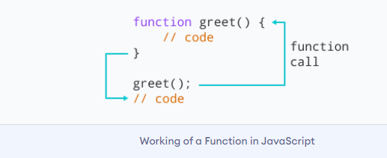
Functions
It can be referred as block of code designed to perform a particular task.
It will be executed when something calls it.
It is defined with the function keyword, followed by a name, followed by parentheses ().
Function names can contain letters, digits, underscores, and dollar signs.
// declaring a function named greet()
function greet() {
console.log("Hello World!");
}
function nameOfFunction () {
// function body
}
// function call
greet();

Slide 46
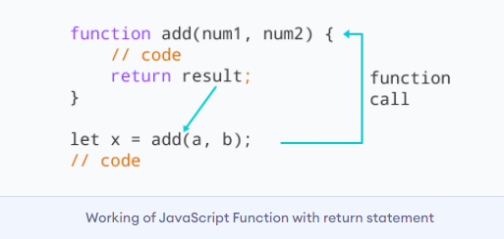
Functions Declaration

Slide 47
Anonymous Function
Anonymous functions in JavaScript do not have a name property. They can be defined using the function keyword, or as an arrow function.
See the code example for the difference between a named function and an anonymous function.
// Named function
function rocketToMars() {
return 'BOOM!';
}
// Anonymous function
const rocketToMars = function() {
return 'BOOM!';
}

Slide 48
Functions Expressions
In Javascript, functions can also be defined as expressions. For example,
Syntax
let name = function(parameters){
// statements
}
let x = function (num) { return num * num };
console.log(x(4)); // 16
// can be used as variable value for other variables
let y = x(3);
console.log(y); // 9

Slide 49
Functions - Nested
function ShowMessage(firstName) {
function SayHello() {
alert("Hello " + firstName);
}
return SayHello();
}
ShowMessage("Board Infinity Learners");

Slide 50
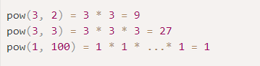
Functions
PROBLEM #05
Write a function pow(x,n) that returns x in power n. Or, in other words, multiplies x by itself n times and returns the result.
Input Description:
Take x and n as input from user
Output Description:
shows the result of pow(x,n).
source: https://javascript.info/function-basics

Slide 51
Your Turn
PROBLEM #06
Write a function min(a,b) which returns the least of two numbers a and b.
Input Description:
Take a, b as input from the user.
Output Description:
print the least number among a and b.

Slide 52
Arrow Function
(ES6)
The syntax for an arrow function expression does not require the function keyword and uses a fat arrow => to separate the parameter(s) from the body.
There are several variations of arrow functions:
Arrow functions with a single parameter do not require () around the parameter list.
Arrow functions with a single expression can use the concise function body which returns the result of the expression without the return keyword.

Slide 53
Comparing traditional functions to arrow functions
Let's decompose a "traditional function" down to the simplest "arrow function" step-by-step:
NOTE: Each step along the way is a valid "arrow function"
// Traditional Function
function (a){
return a + 100;
}
// Arrow Function Break Down
// 1. Remove the word "function" and place arrow between the argument and opening body bracket
(a) => {
return a + 100;
}
// 2. Remove the body brackets and word "return" -- the return is implied.
(a) => a + 100;
// 3. Remove the argument parentheses
a => a + 100;

Slide 54
Comparing traditional functions to arrow functions
For example, if you have multiple arguments or no arguments, you'll need to re-introduce parentheses around the arguments:
// Traditional Function
function (a, b){
return a + b + 100;
}
// Arrow Function
(a, b) => a + b + 100;
// Traditional Function (no arguments)
let a = 4;
let b = 2;
function (){
return a + b + 100;
}
// Arrow Function (no arguments)
let a = 4;
let b = 2;
() => a + b + 100;

Slide 55
Example
// Arrow function with two arguments
const sum = (firstParam, secondParam) => {
return firstParam + secondParam;
};
console.log(sum(2,5)); // Prints: 7
// Arrow function with no arguments
const printHello = () => {
console.log('hello');
};
printHello(); // Prints: hello
// Arrow functions with a single argument
const checkWeight = weight => {
console.log(`Baggage weight : ${weight} kilograms.`);
};
checkWeight(25); // Prints: Baggage weight : 25 kilograms.
// Concise arrow functions
const multiply = (a, b) => a * b;
console.log(multiply(2, 30)); // Prints: 60

Slide 56
Quick Summary of Arrow Functions
Arrow functions can have either “implied return” or “explicit return”
Block body → “return” keyword is required.
Concise body → “return” keyword is implied and not needed.
Parentheses are OPTIONAL for a SINGLE parameter
Parentheses are REQUIRED for MULTIPLE parameter
const myLang = () => { name: "javascript" };
myLang(); // undefined 😱
const myLang= () => ({ name: "javascript" });
myLang(); // { name: "javascript" } ✅

Slide 57
4.10 javascript - Callback Functions
Computers don’t understand JavaScript — browsers do.
Lavanya Seetharaman
Instructor@BoardInfinity

Slide 58
JavaScript CallBack Function
In JavaScript, you can pass a function as an argument to a function. This function that is passed as an argument inside of another function is called a callback function. JavaScript Callback Functions can be used synchronously or asynchronously
function addTwoNumbers(parameterOne, parameterTwo) {
var result = parameterOne + parameterTwo;
return result;
}
addTwoNumbers(100, 200);
function addTwoNumberFunctions(functionOne, functionTwo) {
var functionAdditionResult = functionOne() + functionTwo();
return functionAdditionResult;
}
function functionOneHundred() { return 100; }
function functionTwoHundred() { return 200;}
addTwoNumberFunctions(functionOneHundred, functionTwoHundred);

Slide 59
CallBack Function In Action
Sometimes you may need to take an array and apply some procedure to its elements so that you get a new array with modified elements.
Array.map()
The Array.map() method allows you to iterate over an array and modify its elements using a callback function. The callback function will then be executed on each of the array's elements.
2. Sometimes you may need to take an array elements and it applies conditional statement against it.
if this conditional returns TRUE, the element gets pushed to the output array.If the condition returns false, the element does not get pushed to the output array.
Array.filter()
3. In case, you may need to perform count the total price without using external looping.
Array.reduce()
The reduce() method executes a reducer function (that you provide) on each element of the array, resulting in a single output value.
More details https://www.educative.io/edpresso/how-to-use-the-map-function-in-javascript

Slide 60
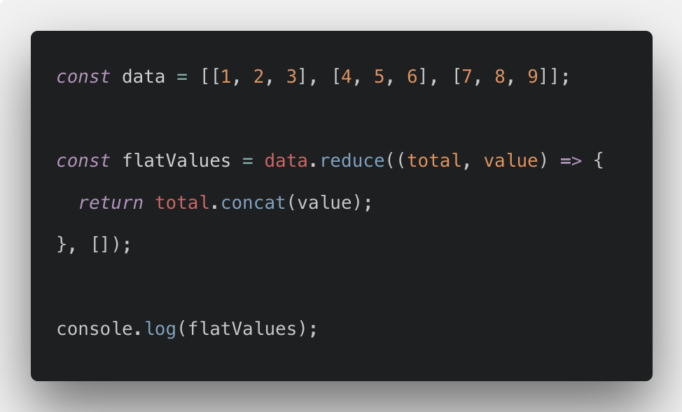
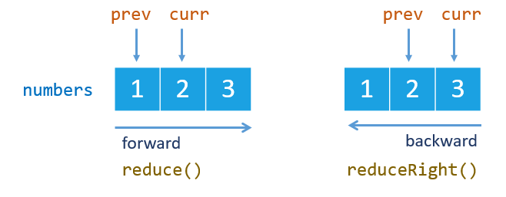
reduce example

Slide 61
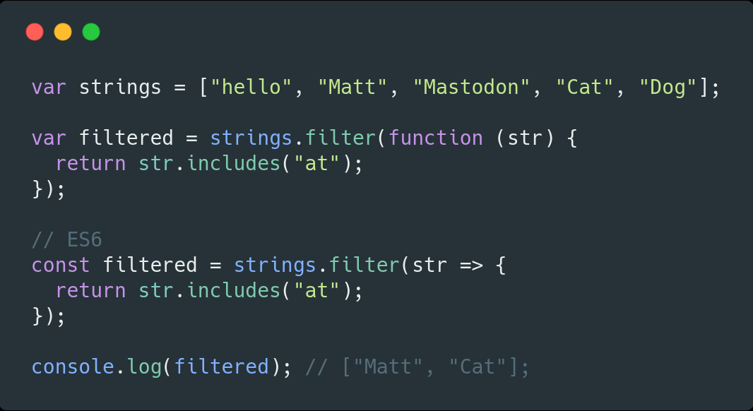
filter example

Slide 62
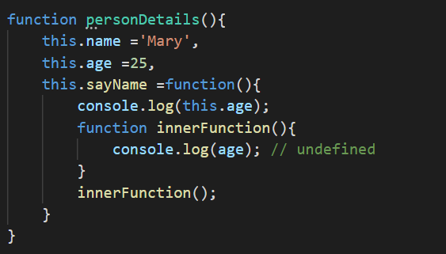
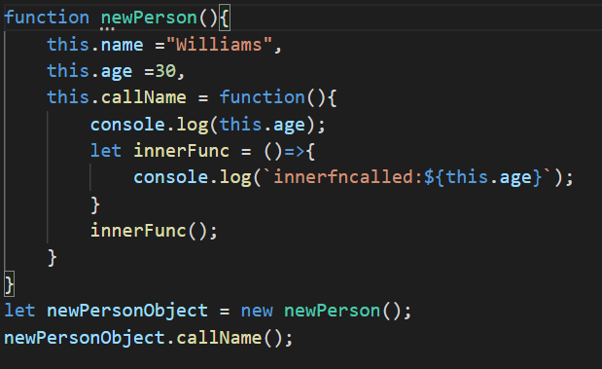


this keyword

Slide 63
4.11 Introduction to DOM Manipulation
Computers don’t understand JavaScript — browsers do.
Lavanya Seetharaman
Instructor@BoardInfinity

Slide 64

Javascript
The Document Object Model (DOM) is a programming interface for HTML. It translates the content of an HTML document into a standardized object that functional programming languages like JavaScript can easily access and modify. Since most web page events are driven by non-HTML code, all dynamic web pages rely on the DOM to display and function properly.
DOM Manipulation

Slide 65

There’s a “root” object called window. It has two roles:
First, it is a global object for JavaScript code.
Second, it represents the “browser window” and provides methods to control it.
bird’s-eye view of what we have when JavaScript runs in a web browser:
function sayHi() {
alert("Hello");
}
// global functions are methods of the global object:
window.sayHi();
Source: https://javascript.info/

Slide 66

DOM (Document Object Model)
entry point
document
For instance:
// change the background color to red
document.body.style.background = "red";

Slide 67


DOM Tree
The backbone of an HTML document is tags.
Obj
HTML tag
Obj
HTML tag
For example, document.body is the object representing the <body> tag.

Slide 68

DOM Tree
The backbone of an HTML document is tags.

Slide 69

source: https://cs.wellesley.edu/~cs110/reading/L11/dom.html

Slide 70

Live DOM Viewer
<!DOCTYPE HTML>
<html>
<head>
<title>About Board Infinity</title>
</head>
<body>
The truth about javascript.
</body>
</html>
DOM View
source: https://software.hixie.ch/utilities/js/live-dom-viewer/

Slide 71

Live DOM Viewer
<!DOCTYPE HTML>
<html><head><title>About Board Infinity</title></head><body>The truth about javascript.</body></html>
DOM View
source: https://software.hixie.ch/utilities/js/live-dom-viewer/

Slide 72
4.12 javascript - DOM Manipulation
Computers don’t understand JavaScript — browsers do.
Lavanya Seetharaman
Instructor@BoardInfinity

Slide 73

How to access elements in the DOM
The DOM allows us to do anything with elements and their contents, but first we need to reach the corresponding DOM object.
All operations on the DOM start with the document object. That’s the main “entry point” to DOM. From it we can access any node.
Here’s a picture of links that allow for travel between DOM nodes:
The topmost tree nodes are available directly as document properties:
<html> = document.documentElement
The topmost document node is document.documentElement. That’s the DOM node of the <html> tag.
<body> = document.body
Another widely used DOM node is the <body> element – document.body.
<head> = document.head
The <head> tag is available as document.head.

Slide 74
How to access elements in the DOM
getElementId - getElementId is a method to access any element virtually. It accesses the first element with the specified ID.
Syntax:
var myVariable = document.getElementById("myId");
myVariable.style.color = "white";
myVariable.style.fontSize= "30px";
myVariable.style.border="solid 1px red";

Slide 75
How to access elements in the DOM
getElementsByTagName: - getElementByTagName allows you to search all the elements with a specified tag name on your page.
Syntax:
var myVariable = document.getElementsByTagName("p");;
var myVariable = document.getElementsByTagName("p");
myVariable[0].style.color="white";
myVariable[0].style.fontSize="40px";
myVariable[0].align ="center";
myVariable[0].style.border="dashed 1px orange";

Slide 76
How to access elements in the DOM
getElementsByTagName: - getElementByTagName allows you to search all the elements with a specified tag name on your page.
Syntax:
var myHandlers = document.getElementsByTagName("p");
for(var i=0;i<myHandlers.length;i++){
myHandlers[i].align ="center";
myHandlers[i].style.color ="white";
myHandlers[i].style.fontWeight="bold";
myHandlers[i].style.border = "solid 1px orange";
myHandlers[i].style.fontVariantCaps="titling-caps";
}

Slide 77
How to access elements in the DOM
getElementsByClassName: - getElementByClassName allows you to search all the elements with a specified class name on your page.
Syntax:
var myHandlers = document.getElementsByClassName("firstHeading");
console.log(myHandlers.length);
for(var i=0;i<myHandlers.length;i++){
myHandlers[i].align ="center";
myHandlers[i].style.color ="white";
myHandlers[i].style.fontWeight="bold";
myHandlers[i].style.border ="solid 2px red";
myHandlers[i].style.borderRadius ="25px";
myHandlers[i].style.padding="20px";
}

Slide 78


How to access elements in the DOM
Node:
Any element on a page including text & whitespaces of a DOM structure is known as “NODE.”
Nodes available in DOM:
node.childNodes
node.firstChild
node.lastChild
node.parentNode
node.nextSibling
node.previousSibling

Slide 79
How to access elements in the DOM
Nodes available in DOM:
node.childNodes- Returns a live NodeList containing all the children of this node (including elements, text and comments). NodeList being live means that if the children of the Node change, the NodeList object is automatically updated.
node.firstChild- Returns a Node representing the first direct child node of the node, or null if the node has no child.
node.lastChild - Returns a Node representing the last direct child node of the node, or null if the node has no child.
node.parentNode - Returns a Node that is the parent of this node. If there is no such node, like if this node is the top of the tree or if doesn't participate in a tree, this property returns null.
node.nextSibling - Returns a Node representing the next node in the tree, or null if there isn't such node.
node.previousSibling-Returns a Node representing the previous node in the tree, or null if there isn't such node.
source: https://developer.mozilla.org/en-US/docs/Web/API/Node

Slide 80


Slide 81



Slide 82
DOM Exercises #1
<!DOCTYPE html>
<html lang="en">
<head>
<meta charset="UTF-8">
<title>Document</title>
</head>
<body>
<div class="header">
</div>
<section id="container">
<ul>
<li class="first">one</li>
<li class="second">two</li>
<li class="third">three</li>
</ul>
<ol>
<li class="first">one</li>
<li class="second">two</li>
<li class="third">three</li>
</ol>
</section>
<div class="footer">
</div>
</body>
</html>
Write the code necessary to do the following:
Select the section with an id of container without using querySelector.
Select the section with an id of container using querySelector.
Select all of the list items with a class of "second".
Select a list item with a class of third, but only the list item inside of the ol tag.
Give the section with an id of container the text "Hello!".
Add the class main to the div with a class of footer.
Remove the class main on the div with a class of footer.
Create a new li element.
Give the li the text "four".
Append the li to the ul element.
Loop over all of the lis inside the ol tag and give them a background color of "green".
Remove the div with a class of footer

Slide 83
DOM Exercises #2
Write the code necessary to do the following:
Create a webpage with an h1 of "My Book List".
Add a script tag to the bottom of the page, where all your JS will go.
Create the array of books of your choice with these parameters . booktitle , author, alreadyread, year
Iterate through the array of books. For each book, create a p element with the book title and author and append it to the page.
Bonus: Use a ul and li to display the books.
Bonus: add a property to each book with the URL of the book cover, and add an img element for each book on the page.
Bonus: Change the style of the book depending on whether you have read it or not.

Slide 84
DOM Exercises #3
<!DOCTYPE html>
<html>
<head>
<meta charset="utf-8"/>
<title>About Me</title>
</head>
<body>
<h1>About Me</h1>
<ul>
<li>Nickname: <span id="nickname"></span>
<li>Favorites: <span id="favorites"></span>
<li>Hometown: <span id="hometown"></span>
</ul>
</body>
</html>
Write the code necessary to do the following:
Add a script tag to the bottom.
Change the body style so it has a font-family of "Arial, sans-serif".
Replace each of the spans (nickname, favorites, hometown) with your own information.
Iterate through each li and change the class to "listitem". Add a style tag that sets a rule for "listitem" to make the color red.
Create a new img element and set its src attribute to a picture of you. Append that element to the page.
Your Turn

Slide 85
4.13 javascript - Events
Computers don’t understand JavaScript — browsers do.
Lavanya Seetharaman
Instructor@BoardInfinity

Slide 86


Slide 87
Events
an event
When ____________ happens , do _______ .
react to event
source:https://www.kirupa.com/html5/javascript_events.htm

Slide 88
Events in JavaScript
Listen to events
React to events
The way we use this function looks as follows:
source.addEventListener(eventName, eventHandler, false);
to capture or not to capture ( true or false)
DOM element such as document , window or any object
click, mousemove,mouseover...
specify a function that will get called when the event gets overheard
source:https://www.kirupa.com/html5/javascript_events.htm

Slide 89
Events in JavaScript
Putting It All Together
let's tie it all up with an example of this function fully decked out:
document.addEventListener("click", changeColor, false);
function changeColor(event) {
// I am event handler!!!
}
event object contains properties that are relevant to the event that was fired.
Some of the popular properties from the Event type that we will use are:
# currentTarget
# target
# preventDefault
# stopPropagation
# type

Slide 90
Events in JavaScript
Like add , yes ! we can remove an event listener
document.removeEventListener("click", changeColor, false);
function changeColor(event) {
document.body.style.backgroundColor =”FFFFF”;
}

Slide 91


Events in JavaScript
Events using Arrow Functions
source.addEventListener("eventname",event=>{
// Write your own code
});
Events:
Keyboard

Slide 92

Visualize the DOM Elements

Slide 93
Events Exercises #1
Part 1
Add the necessary code to wait for the DOM to load to make sure that anything you manipulate in the DOM has loaded. You can do this either using window.onload or adding an event listener for DOMContentLoaded.
Replace the text "Change me" with "Hello World!".
When a user hovers over one of the colored boxes change the text to display the color that is being hovered over.
Create a new div element.
Give your new div a class of purple and style it so that it has a background color of purple.
Append your new div to the page to the section tag.
Part 2
Combining your knowledge of DOM access and events to build a todo app!
As a user, you should be able to:
Add a new todo (by click add task )
Mark a todo as completed (cross out the text of the todo)
Part 3
Create a racing game with the two cars. When the race button is pressed, the two cars should move across the screen until one of them is at the end of the screen. When one of the blocks reaches the end - you should alert "winner!".
Hint : use setInterval(), clearTimeout().

Slide 94
4.14 javascript - form validation
Computers don’t understand JavaScript — browsers do.
Lavanya Seetharaman
Instructor@BoardInfinity

Slide 95
Client-side Form validation in JavaScript
It is important to validate the form submitted by the user because it can have inappropriate values. So, validation is must to authenticate user.
Before submitting data to the server, it is important to ensure all required form controls are filled out, in the correct format. This is called client-side form validation.
JavaScript provides facility to validate the form on the client-side so data processing will be faster than server-side validation. Most of the web developers prefer JavaScript form validation.
Through JavaScript,
name,
password,
email,
date,
mobile numbers and more fields.
You'll get messages such as:
"This field is required" (You can't leave this field blank).
"Please enter your phone number in the format xxx-xxxx" (A specific data format is required for it to be considered valid).
"Please enter a valid email address" (the data you entered is not in the right format).
"Your password needs to be between 8 and 30 characters long and contain one uppercase letter, one symbol, and a number." (A very specific data format is required for your data).
more details : https://developer.mozilla.org/en-US/docs/Learn/Server-side/First_steps/Website_security

Slide 96


Different types of client-side validation
There are two different types of client-side validation that you'll encounter on the web:
Built-in form validation uses HTML5 form validation features. This validation generally doesn't require much JavaScript. Built-in form validation has better performance than JavaScript, but it is not as customizable as JavaScript validation.
JavaScript validation is coded using JavaScript. This validation is completely customizable, but you need to create it all (or use a library).
More Details : https://developer.mozilla.org/en-US/docs/Learn/Forms/HTML5_input_types

Slide 97

Constraint Validation API
Validity State, allows us to use the browser’s own field validation algorithms in our scripts instead of writing our own.
Validity State
The validity property provides a set of information about a form field, in the form of boolean (true/false) values.
var myField = document.querySelector('input[type="text"]');
var validityState = myField.validity;
The returned object contains the following properties:
valid – Is true when the field passes validation.
valueMissing – Is true when the field is empty but required.
typeMismatch – Is true when the field type is email or url but the entered value is not the correct type.
tooShort – Is true when the field contains a minLength attribute and the entered value is shorter than that length.
tooLong – Is true when the field contains a maxLength attribute and the entered value is longer than that length.
patternMismatch – Is true when the field contains a pattern attribute and the entered value does not match the pattern.
badInput – Is true when the input type is number and the entered value is not a number.
stepMismatch – Is true when the field has a step attribute and the entered value does not adhere to the step values.
rangeOverflow – Is true when the field has a max attribute and the entered number value is greater than the max.
rangeUnderflow – Is true when the field has a min attribute and the entered number value is lower than the min.
source:https://quirksmode.org/html5/inputs/
Notes:
https://css-tricks.com/form-validation-part-2-constraint-validation-api-javascript/

Slide 98
4.15 javascript - Async/Await
Computers don’t understand JavaScript — browsers do.
Lavanya Seetharaman
Instructor@BoardInfinity

Slide 99
What is a Synchronous ?
Synchronous vs Asynchronous
What is an Asynchronous ?
tasks are completed one after another.
tasks are completed independently
"async and await make promises easier to write"
async makes a function return a Promise
await makes a function wait for a Promise
Async/AWait
async function example() {
let promise = new Promise((resolve, reject) => {
setTimeout(() => resolve("done!"), 2000)
});
let result = await promise; // wait until the promise resolves (*)
alert(result); // "done!"
}
example();
Async/Await makes it easier to write promises.
The keyword ‘async’ before a function makes the function return a promise, always.
And the keyword await is used inside async functions, which makes the program wait until the Promise resolves.
Notes:
https://www.freecodecamp.org/news/synchronous-vs-asynchronous-in-javascript/

Slide 100
Async/Await
The word “async” before a function means one simple thing: a function always returns a promise. Other values are wrapped in a resolved promise automatically.
Let’s start with the async keyword. It can be placed before a function, like this:
async function f() {
return 1;
}
async function f() {
return Promise.resolve(1);
}
f().then(alert); // 1
f().then(alert);// 1
Await
async function f() {
let promise = new Promise((resolve, reject) => {
setTimeout(() => resolve("done!"), 1000)
});
let result = await promise; // wait until the promise resolves (*)
alert(result); // "done!"
}
f();
// works only inside async functions
let value = await promise;
The keyword await makes JavaScript wait until that promise settles and returns its result.
Here’s an example with a promise that resolves in 1 second:

Slide 101
4.16 javascript - promise
Computers don’t understand JavaScript — browsers do.
Lavanya Seetharaman
Instructor@BoardInfinity

Slide 102

Promise
Promises are one of the ways we can deal with asynchronous operations in JavaScript.
A Promise is an object representing the eventual completion or failure of an asynchronous operation.
A promise has 2 possible outcomes: it will either be kept when the time comes, or it won’t.
When we define a promise in JavaScript, it will be resolved when the time comes, or it will get rejected.
Three States of the Promise Object:
Pending: Initial State, before the Promise succeeds or fails
fulfilled or Resolved: Completed Promise
Rejected: Failed Promise
Promise.all()
Promise.race()
Promise.resolve()
Promise.reject()
Representation of the process of Promises
Notes:
https://www.freecodecamp.org/news/javascript-es6-promises-for-beginners-resolve-reject-and-chaining-explained/

Slide 103

Promise
Representation of the process of Promises
Creating and Using A Promise Step by Step
Firstly, we use a constructor to create a Promise object:
const myPromise = new Promise();
It takes two parameters, one for success (resolve) and one for fail (reject):
const myPromise = new Promise((resolve, reject) => {
// condition
});
Finally, there will be a condition. If the condition is met, the Promise will be resolved, otherwise it will be rejected:
const myPromise = new Promise((resolve, reject) => {
let condition;
if(condition is met) {
resolve('Promise is resolved successfully.');
} else {
reject('Promise is rejected');
}
});

Slide 104
Promise
Creating and Using A Promise Step by Step
Representation of the process of Promises
If the Promise gets resolved (success case),then something will happen next (depends on what we do with the successful Promise).
myPromise.then();
What if the Promise fails? Then, we need to use the catch( ) method.
myPromise.catch();
myPromise.then((message) => {
console.log(message);
}).catch((message) => {
console.log(message);
});

Slide 105


Promises & Callback

Slide 106
Chaining promises
A promise can be returned to another promise, creating a chain of promises.
A great example of chaining promises is the Fetch API, which we can use to get a resource and queue a chain of promises to execute when the resource is fetched.
The Fetch API is a promise-based mechanism, and calling fetch() is equivalent to defining our own promise using new Promise().
const status = response => {
if (response.status >= 200 && response.status < 300) {
return Promise.resolve(response)
}
return Promise.reject(new Error(response.statusText))
}
const json = response => response.json()
fetch('/todos.json')
.then(status)
.then(json)
.then(data => {
console.log('Request succeeded with JSON response', data)
})
.catch(error => {
console.log('Request failed', error)
})
1
The first promise in the chain is a function that we defined, called status()
2
If first promise succeeds, it calls the json() function
3
The third promise receives the JSON directly
Notes:
https://nodejs.dev/learn/understanding-javascript-promises
https://gist.github.com/csmalin/22fbe7ccbf064c7073fae5d07da3d154

Slide 107
Books/Links for Reference
https://addyosmani.com/resources/essentialjsdesignpatterns/book/
https://jsbooks.revolunet.com/
https://www.freecodecamp.org/news/javascript-map-reduce-and-filter-explained-with-examples/
https://oscarrobertrodriguez.github.io/exercisesModernDeveloper/javascript-events-in-depth/
Event handlers - https://www.cs.uct.ac.za/mit_notes/web_programming/html/ch15.html
https://developer.mozilla.org/en-US/docs/Learn/JavaScript/Building_blocks/Events
https://eloquentjavascript.net/15_event.html
https://www.kirupa.com/html5/javascript_events.htm
https://www.freecodecamp.org/news/javascript-event-handlers/

Slide 108

Practice

